Slide 1
Sugartown smoked foods
Team Rotisserie
Jason Chou, Reed Lerner, Reginald Ferguson, Jake Heichert, Garett Cary, Alice Lee

Slide 2
Road Map
Intro
Theory
Hypothesis
Experiment
Design
Implement
Conclusions
Results
Suggestions

Slide 3
Sugartown
Award winning smoked foods
You know the rest…
Main area for improvement
-Web sales: 9%
Theory & Hypothesis | Experiment & Implement | Results & Suggestions

Slide 4
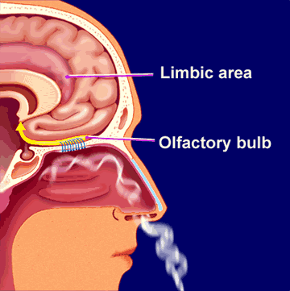
Shopping in Person
Sensory Stimulation
-Visual
-Smell
-Taste
-Touch
Factor into WTP & expected satisfaction
Theory & Hypothesis | Experiment & Implement | Results & Suggestions

Slide 5
Shopping Online
Sensory Stimulation
-Visual
-Smell
-Taste
-Touch
Increase by framing description and peripheral design
Theory & Hypothesis | Experiment & Implement | Results & Suggestions

Slide 6
Hypothesis
Emphasizing sensory features of the webpage will increase willingness to pay and expected satisfaction.
Theory & Hypothesis | Experiment & Implement | Results & Suggestions

Slide 7
Proposed Experiment
Online
In-person
Meal Framed
Images
1 | 2
3 | 4
5 | 6
7 | 8
9 | 10
11 | 12
Price Info
Images
Original
Description
Sensory
Description
Regular Customer
Testimonial
Expert
Testimonial
Theory & Hypothesis | Experiment & Implement | Results & Suggestions

Slide 8
Actual Experiment
Original Site
New Site
Original
Description
1 | 2
3 | 4
New
Description
Theory & Hypothesis | Experiment & Implement | Results & Suggestions

Slide 9
Experimental Variables
Stimulate taste, smell, and sight
Independent variables
-Emphasize sensory language in product
description
-Modify the peripheral design of the site
Dependent variables
-Willingness to pay
-Expected satisfaction
-Hunger
Theory & Hypothesis | Experiment & Implement | Results & Suggestions

Slide 10
Execution of Independent Variables
Product Descriptions
The Sugartown Smoked Specialties production staff meticulously hand trim and cure the freshest North Atlantic Salmon fillets, then cold smoke them in our European made smokehouse. The result is a buttery, melt in your mouth Nova, sliced paper thin, with the perfect salt to sugar ratio. The salmon comes packaged on its own serving board, and is available in your choice of (4) - 4 ounce packages (perfect for gifting), 8 ounce, 16 ounce and whole fillets. Fillets average 2.2 pounds.
This Nova Style Smoked Salmon is known for its buttery, melt in your mouth taste. The delightfully aromatic fillets are sliced paper thin and have the perfect salt to sugar ratio. The freshest North Atlantic Salmon are meticulously hand trimmed, cured, and then cold smoked in our European made smokehouse. The salmon comes packaged on its own serving board, and is available in your choice of (4) - 4 ounce packages (perfect for gifting), 8 ounce, 16 ounce and whole fillets. Fillets average 2.2 pounds.
Theory & Hypothesis | Experiment & Implement | Results & Suggestions
Notes:
10

Slide 11
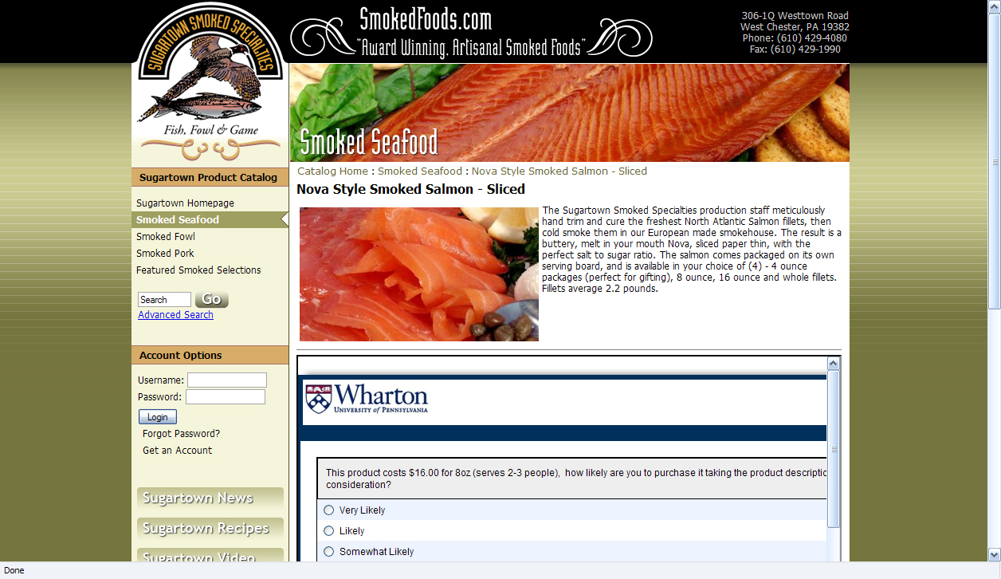
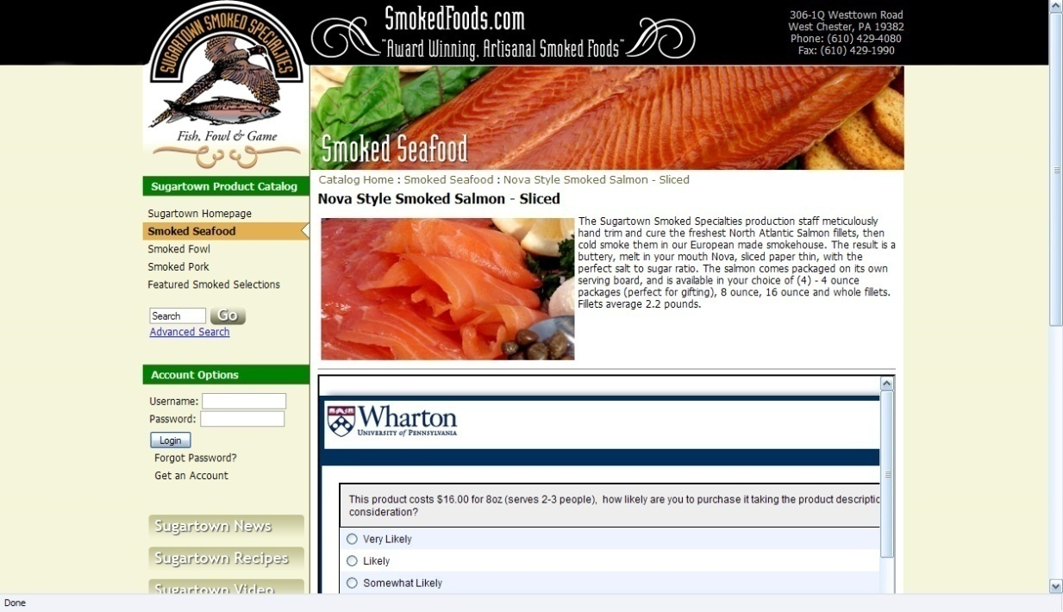
Execution of Independent Variables
Peripheral Site Design
Theory & Hypothesis | Experiment & Implement | Results & Suggestions
Notes:
11

Slide 12
Implementation
Online survey
-Embedded in website
Wide delivery
Theory & Hypothesis | Experiment & Implement | Results & Suggestions

Slide 13
Respondents.
Male | Female
51.25% | 48.75%
Average Age: 28.7
Theory & Hypothesis | Experiment & Implement | Results & Suggestions

Slide 14
Overall Response
Theory & Hypothesis | Experiment & Implement | Results & Suggestions

Slide 15
Possible Limitations
Age of respondents
-May be missing the target markets
Proportion of visitors to buyers
3% of traffic from Google
Most hits from searches with “Smoked” or “Sugartown”
Theory & Hypothesis | Experiment & Implement | Results & Suggestions

Slide 16
The results agreed with our expectations.
Theory & Hypothesis | Experiment & Implement | Results & Suggestions

Slide 17
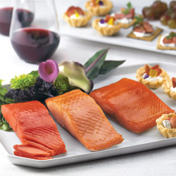
Suggestions
Sensory language
Put consumers in a “hot” buying state
Peripheral cues are important
A simple color change can make a difference
Theory & Hypothesis | Experiment & Implement | Results & Suggestions

Slide 18
Questions…
Team Rotisserie
Jason Chou, Reed Lerner, Reginald Ferguson, Jake Heichert, Garett Cary, Alice Lee

